Slide 1
BLOG SITE
Submitted To: Submitted By: Khan Md. Hasib Name: Sheikh Afrin
Lecturer , Department of CSE ID: UG02-47-18-040
State University Of Bangladesh

Slide 2
INTRODUCTION
Blogs are a new and intriguing form of communication and personal expression.
A blog is a type of website that is updated regularly with new content.
Most blogs contain short, informal articles called blog posts.
These posts usually contain some combination of text, photos, videos, and other media.
If you spend much time browsing the Web, you've probably read a blog post before, even if you didn't realize it at the time.
At its core, a blog is just a space on the Web that you can create to record and express your opinions, experiences, and interests.

Slide 3
Why Blog?
There are many reasons why people blog, but here are some of the most common reasons:
To share your experiences and expertise
To speak up about an issue you care about
To become more involved with hobbies and passions
To be part of a community
To advance your career or start a career in writing
To keep family and friends updated about your life

Slide 4
Features
1.Admin Panel
2.Post Blogs
3.Blog categories
4.Drafts
5.Editor’s choice
6.Social links
7.Admin stats

Slide 5
Modules
The entire project mainly consists of 2 modules, which are
1.Admin module
2.User module

Slide 6
Using Tools
Language
Front-end: HTML, CSS and JAVASCRIPT
Back-end: PHP and JavaScript
Database: MySQL
Web Browser: Mozilla, Google Chrome, OPERA
Software: XAMPP Server

Slide 7
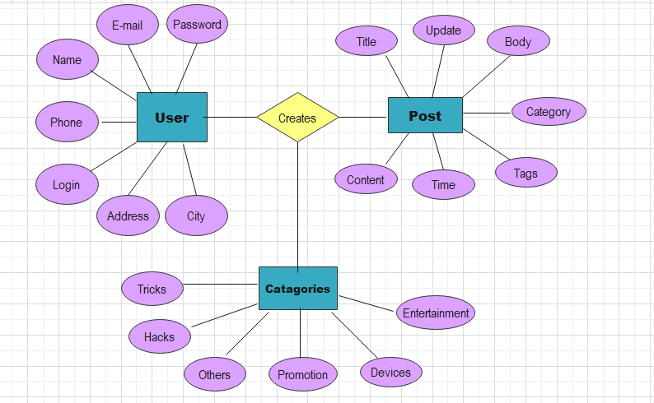
ER DIAGRAM

Slide 8
Advantages
It saves time. You won't have to check multiple blogs each day to see if they've added new posts.
You'll be able to read posts on many topics and from various blogs, all in one place.
You will improve your writing skills
You can manage your online identity and build trust
You could become proficient in a new language.
You will connect an expert.

Slide 9
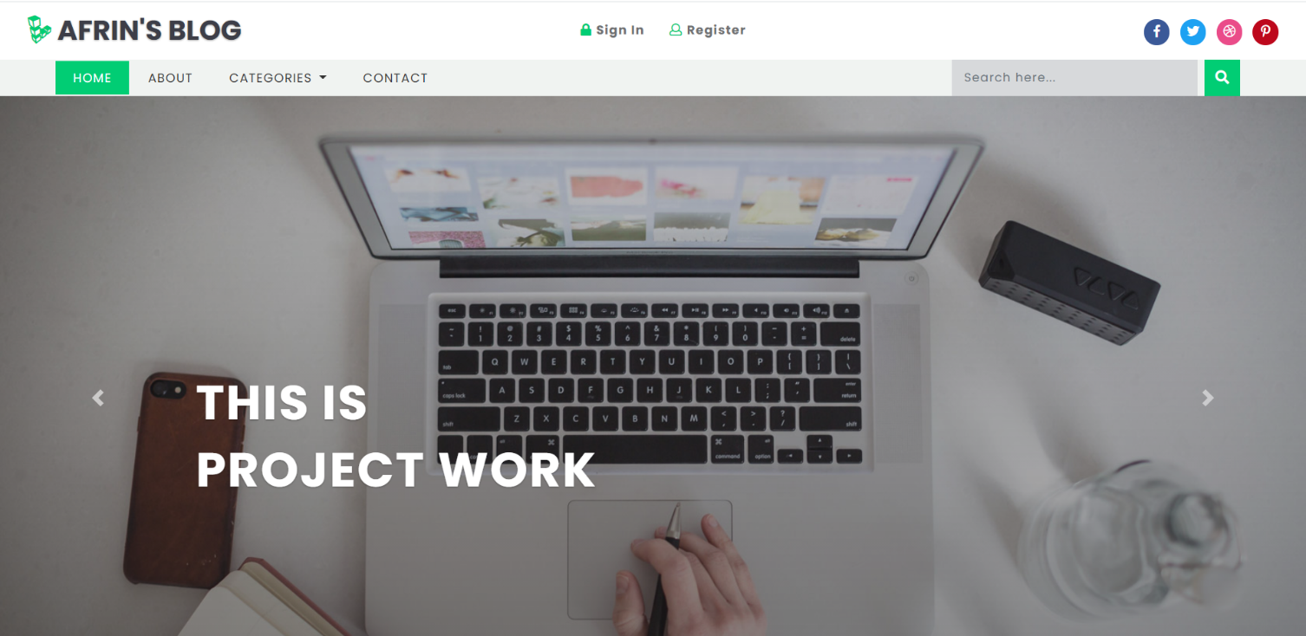
Home Page

Slide 10
Conclusion
Blogs are a new and intriguing form of communication and personal expression.
Reading a variety of blogs can be a great way to learn about new things, be entertained, or get news from a certain perspective.
But the more blogs you read, the more difficult it can be to keep up with them all.

